Slide 1
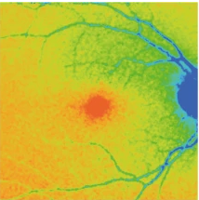
FLIO
A New Dimension of Imaging
Siem Yonas
Image Adapted from Sauer, Fluorescence, 2020

Slide 2
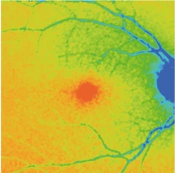
FLIO?
Fluorescence Lifetime Imaging Ophthalmoscopy
Innovative technique in fluorescent imaging
Unique, high contrast information on the retina
Sauer, Fluorescence, 2020

Slide 3
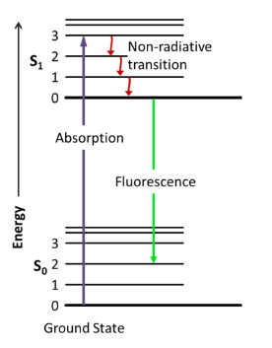
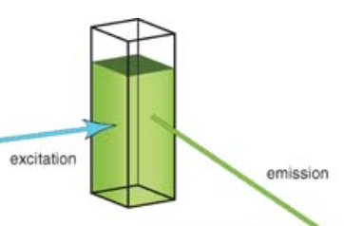
Fluorescence
Adapted from chem.libretexts.org, Fluorescence

Slide 4
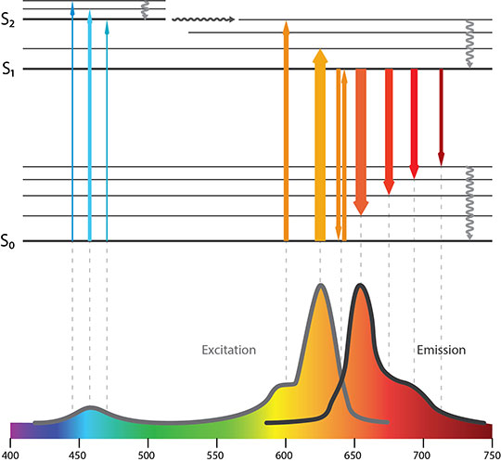
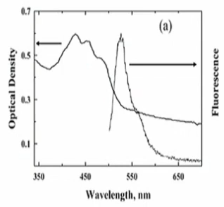
Dimensions of Fluorescence: Spectral
https://www.enzolifesciences.com/science-center/technotes/2019/december/what-is-the-difference-between-fluorescence-phosphorescence-and-luminescence?/
Sauer, Clinical Advances, 2019

Slide 5
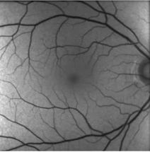
Dimensions of Fluorescence: Brightness
Intensity
Adapted from https://www.enzolifesciences.com/science-center/technotes/2019/december/what-is-the-difference-between-fluorescence-phosphorescence-and-luminescence?/
Sauer, Fluorescence, 2020

Slide 6
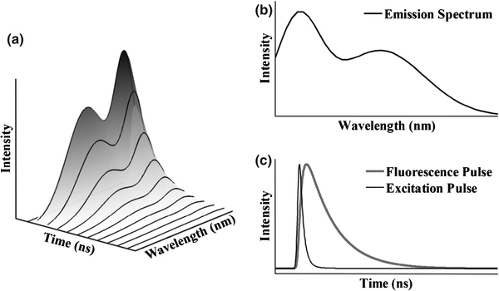
Dimensions of Fluorescence: Lifetime
Marcu, Fluorescence, 2012

Slide 7
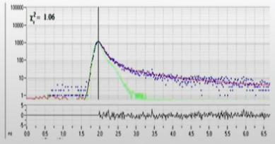
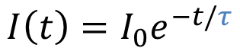
Dimensions of Fluorescence: Lifetime
$$I\left(t\right)=I_{0}e^{−t/τ}$$
Photon Counts
Time (ns)
Sauer, Clinical Advances, 2019
Sauer, Fluorescence, 2020

Slide 8
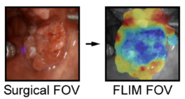
Usages of Fluorescence Lifetime Imaging
Cancer Diagnosis
Gastrointestinal Tract
Lung
Head/Neck
Brain
Atherosclerotic Disease
Skin Evaluations
Ophthalmology
Datta, Recent Innovations, 2021

Slide 9
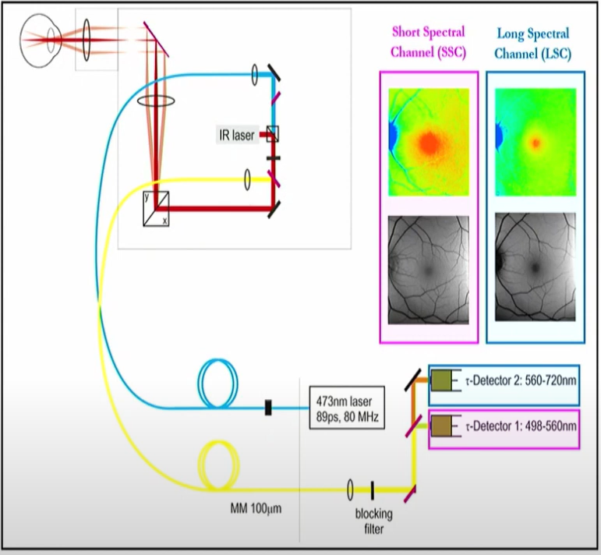
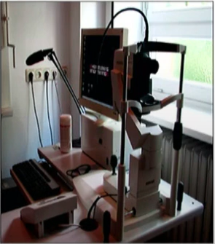
FLIO Set Up
Sauer, Clinical Advances, 2019

Slide 10
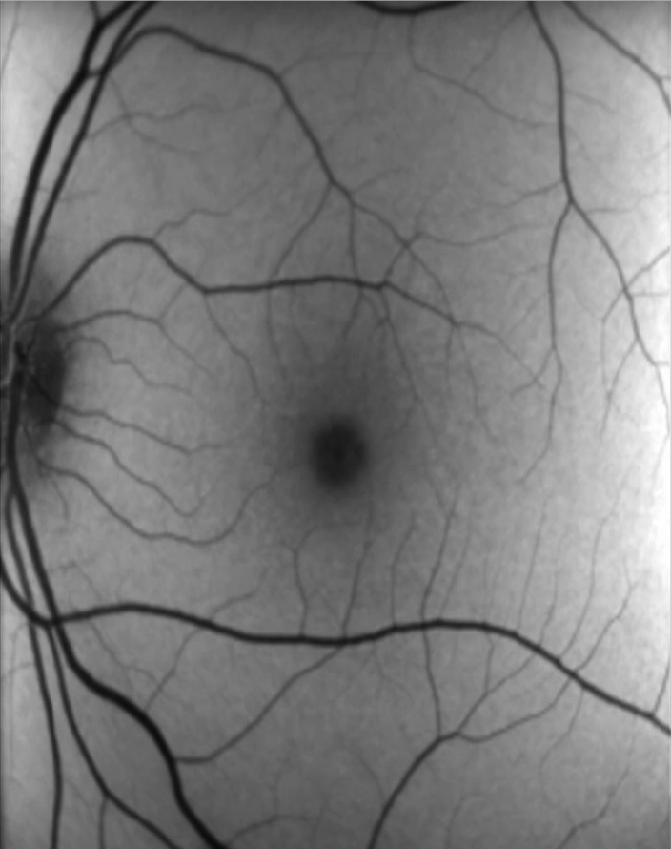
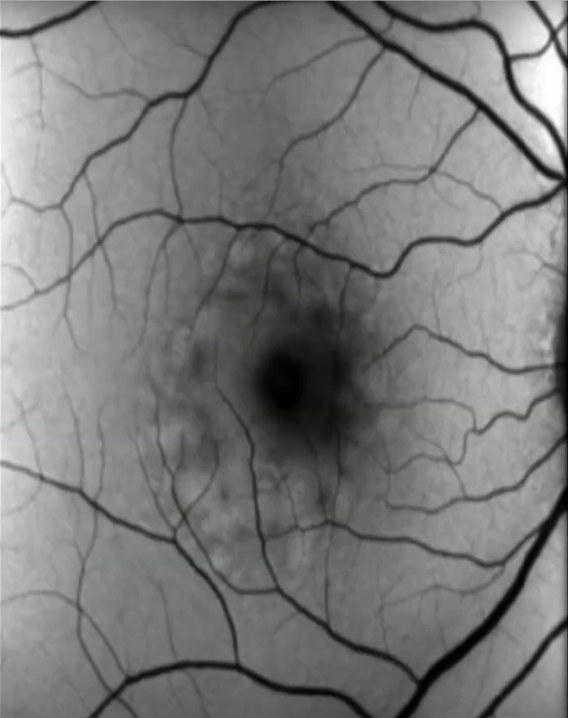
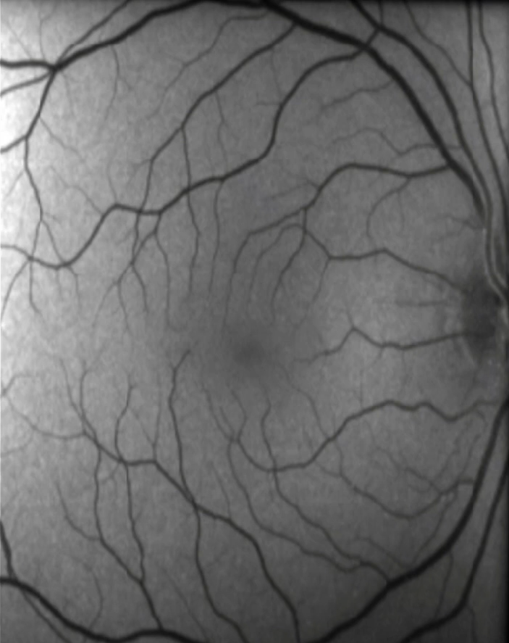
Hidden Patterns
Sauer, Clinical Advances, 2019

Slide 11
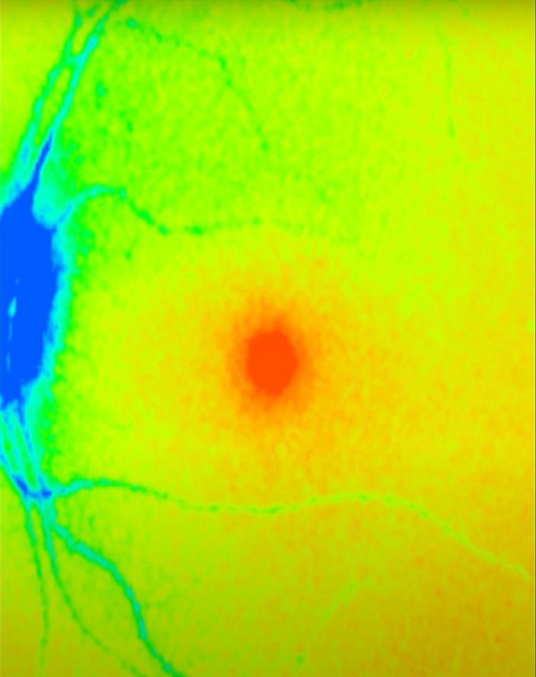
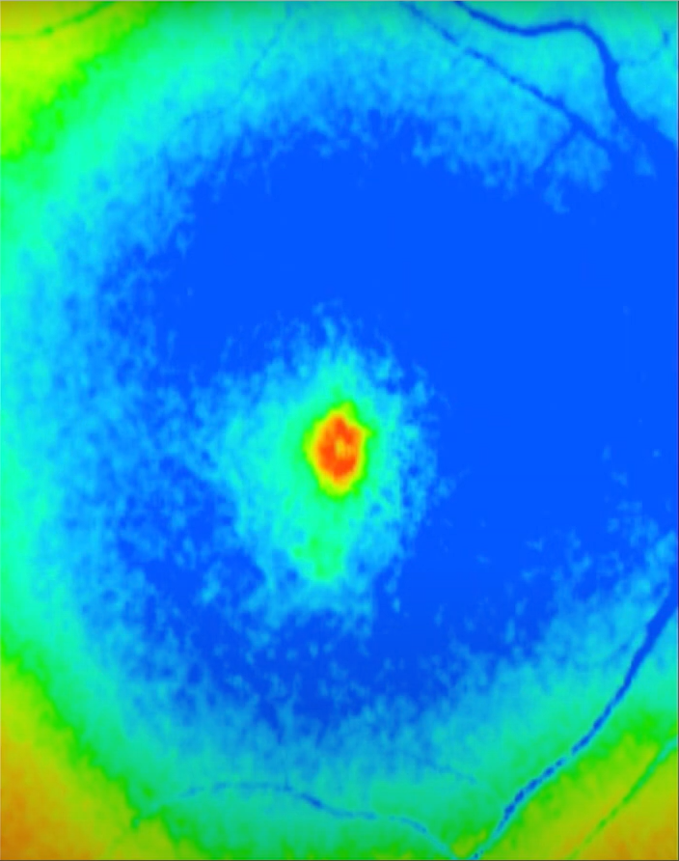
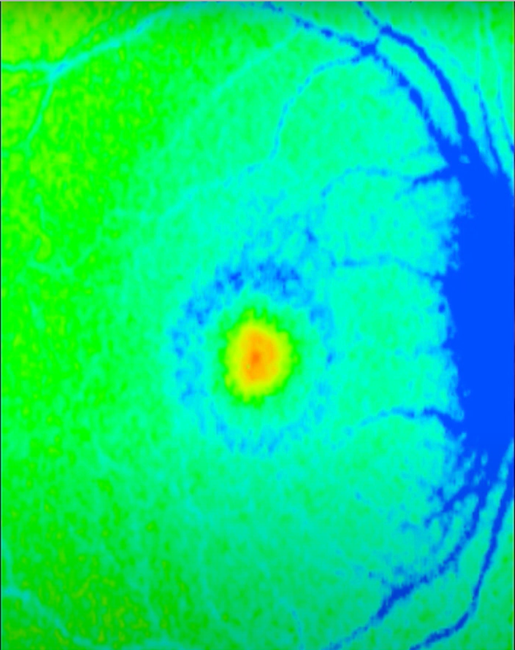
Hidden Patterns
Sauer, Clinical Advances, 2019

Slide 12
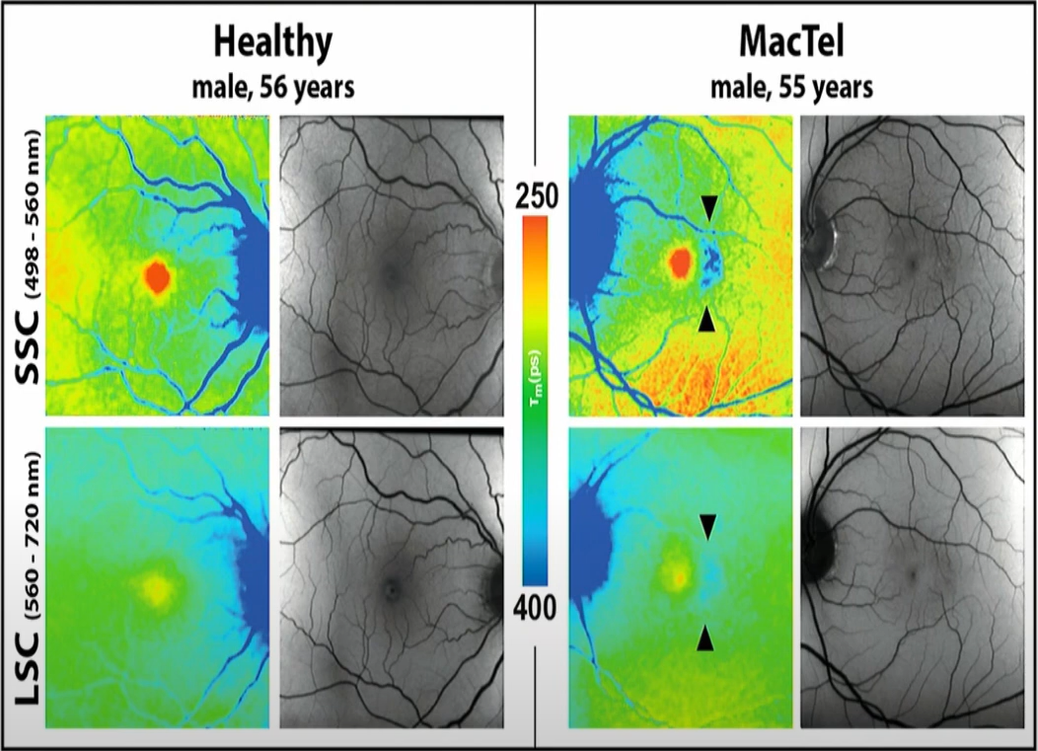
Hidden Patterns
Sauer, Clinical Advances, 2019

Slide 13
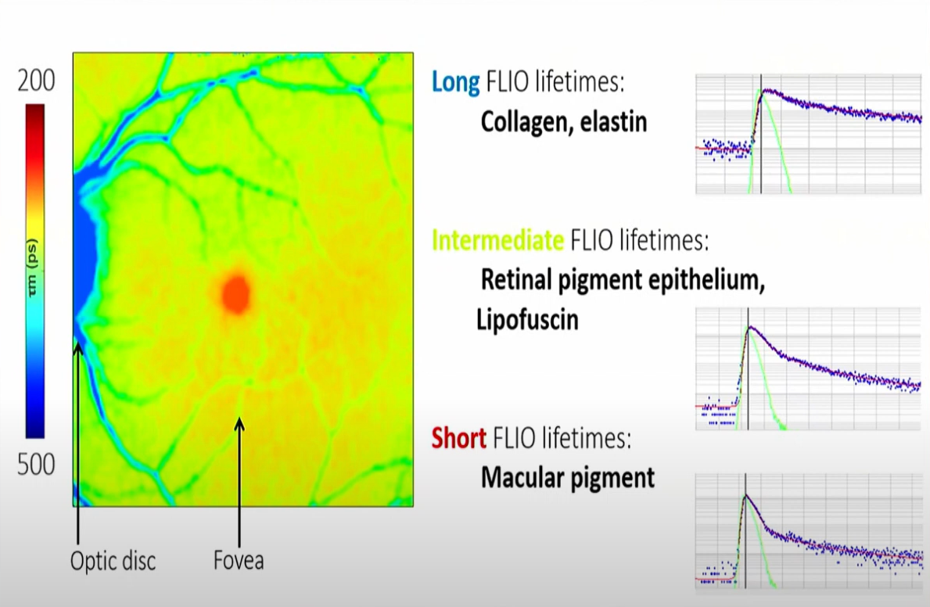
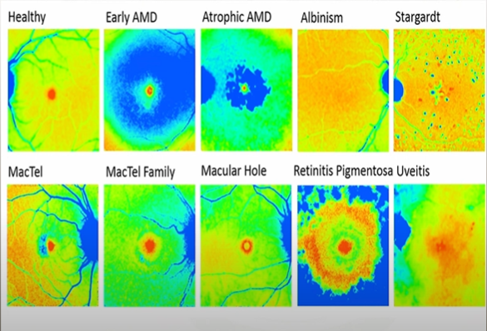
Characteristic Patterns for Diseases
Sauer, Clinical Advances, 2019

Slide 14
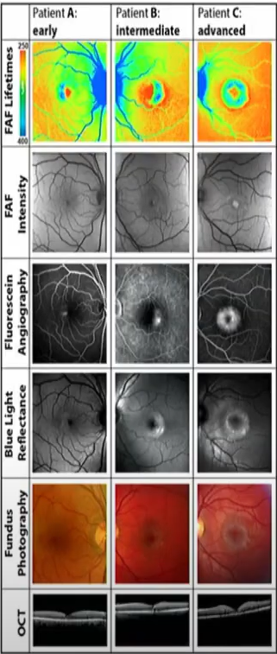
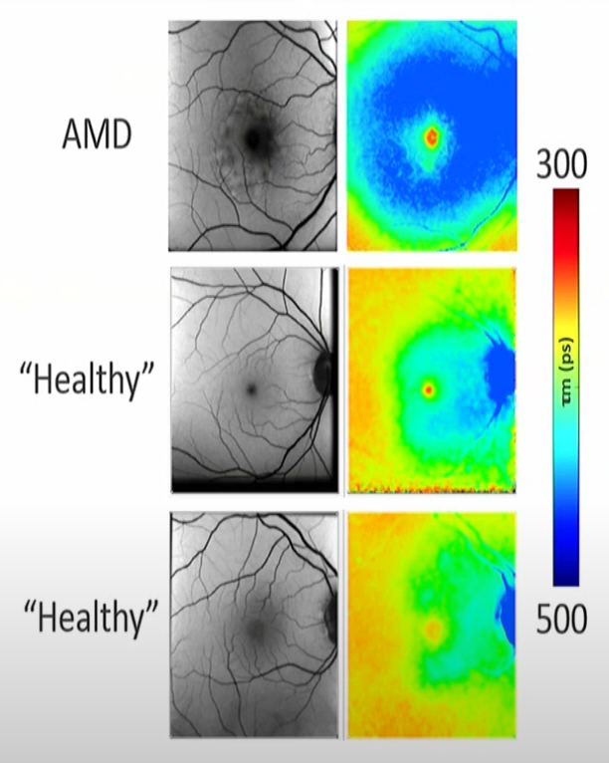
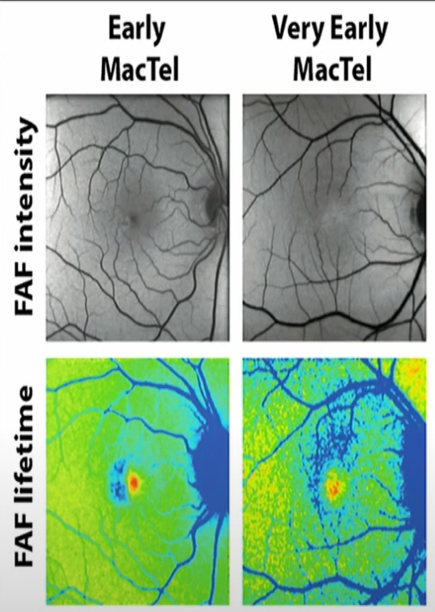
Early Detection
Sauer, Clinical Advances, 2019

Slide 15
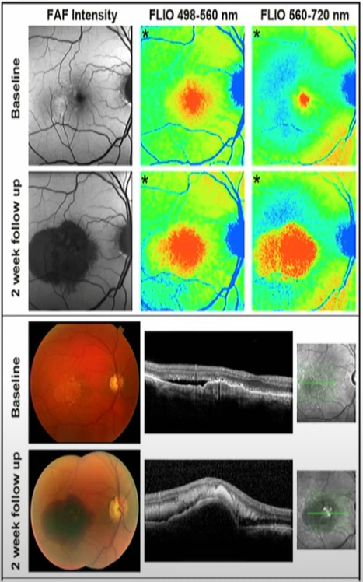
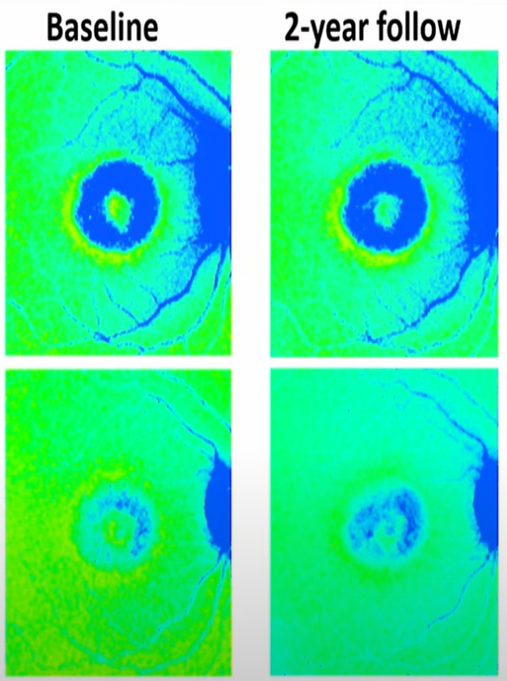
Disease Progression
Sauer, Clinical Advances, 2019

Slide 16
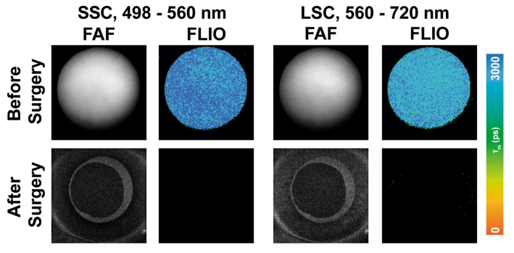
FLIO in the Future
Higher Accessibility
More Retinal Diseases
Anterior Segment Conditions
Diabetes and Alzheimer's
Sauer, Fluorescence, 2020

Slide 17
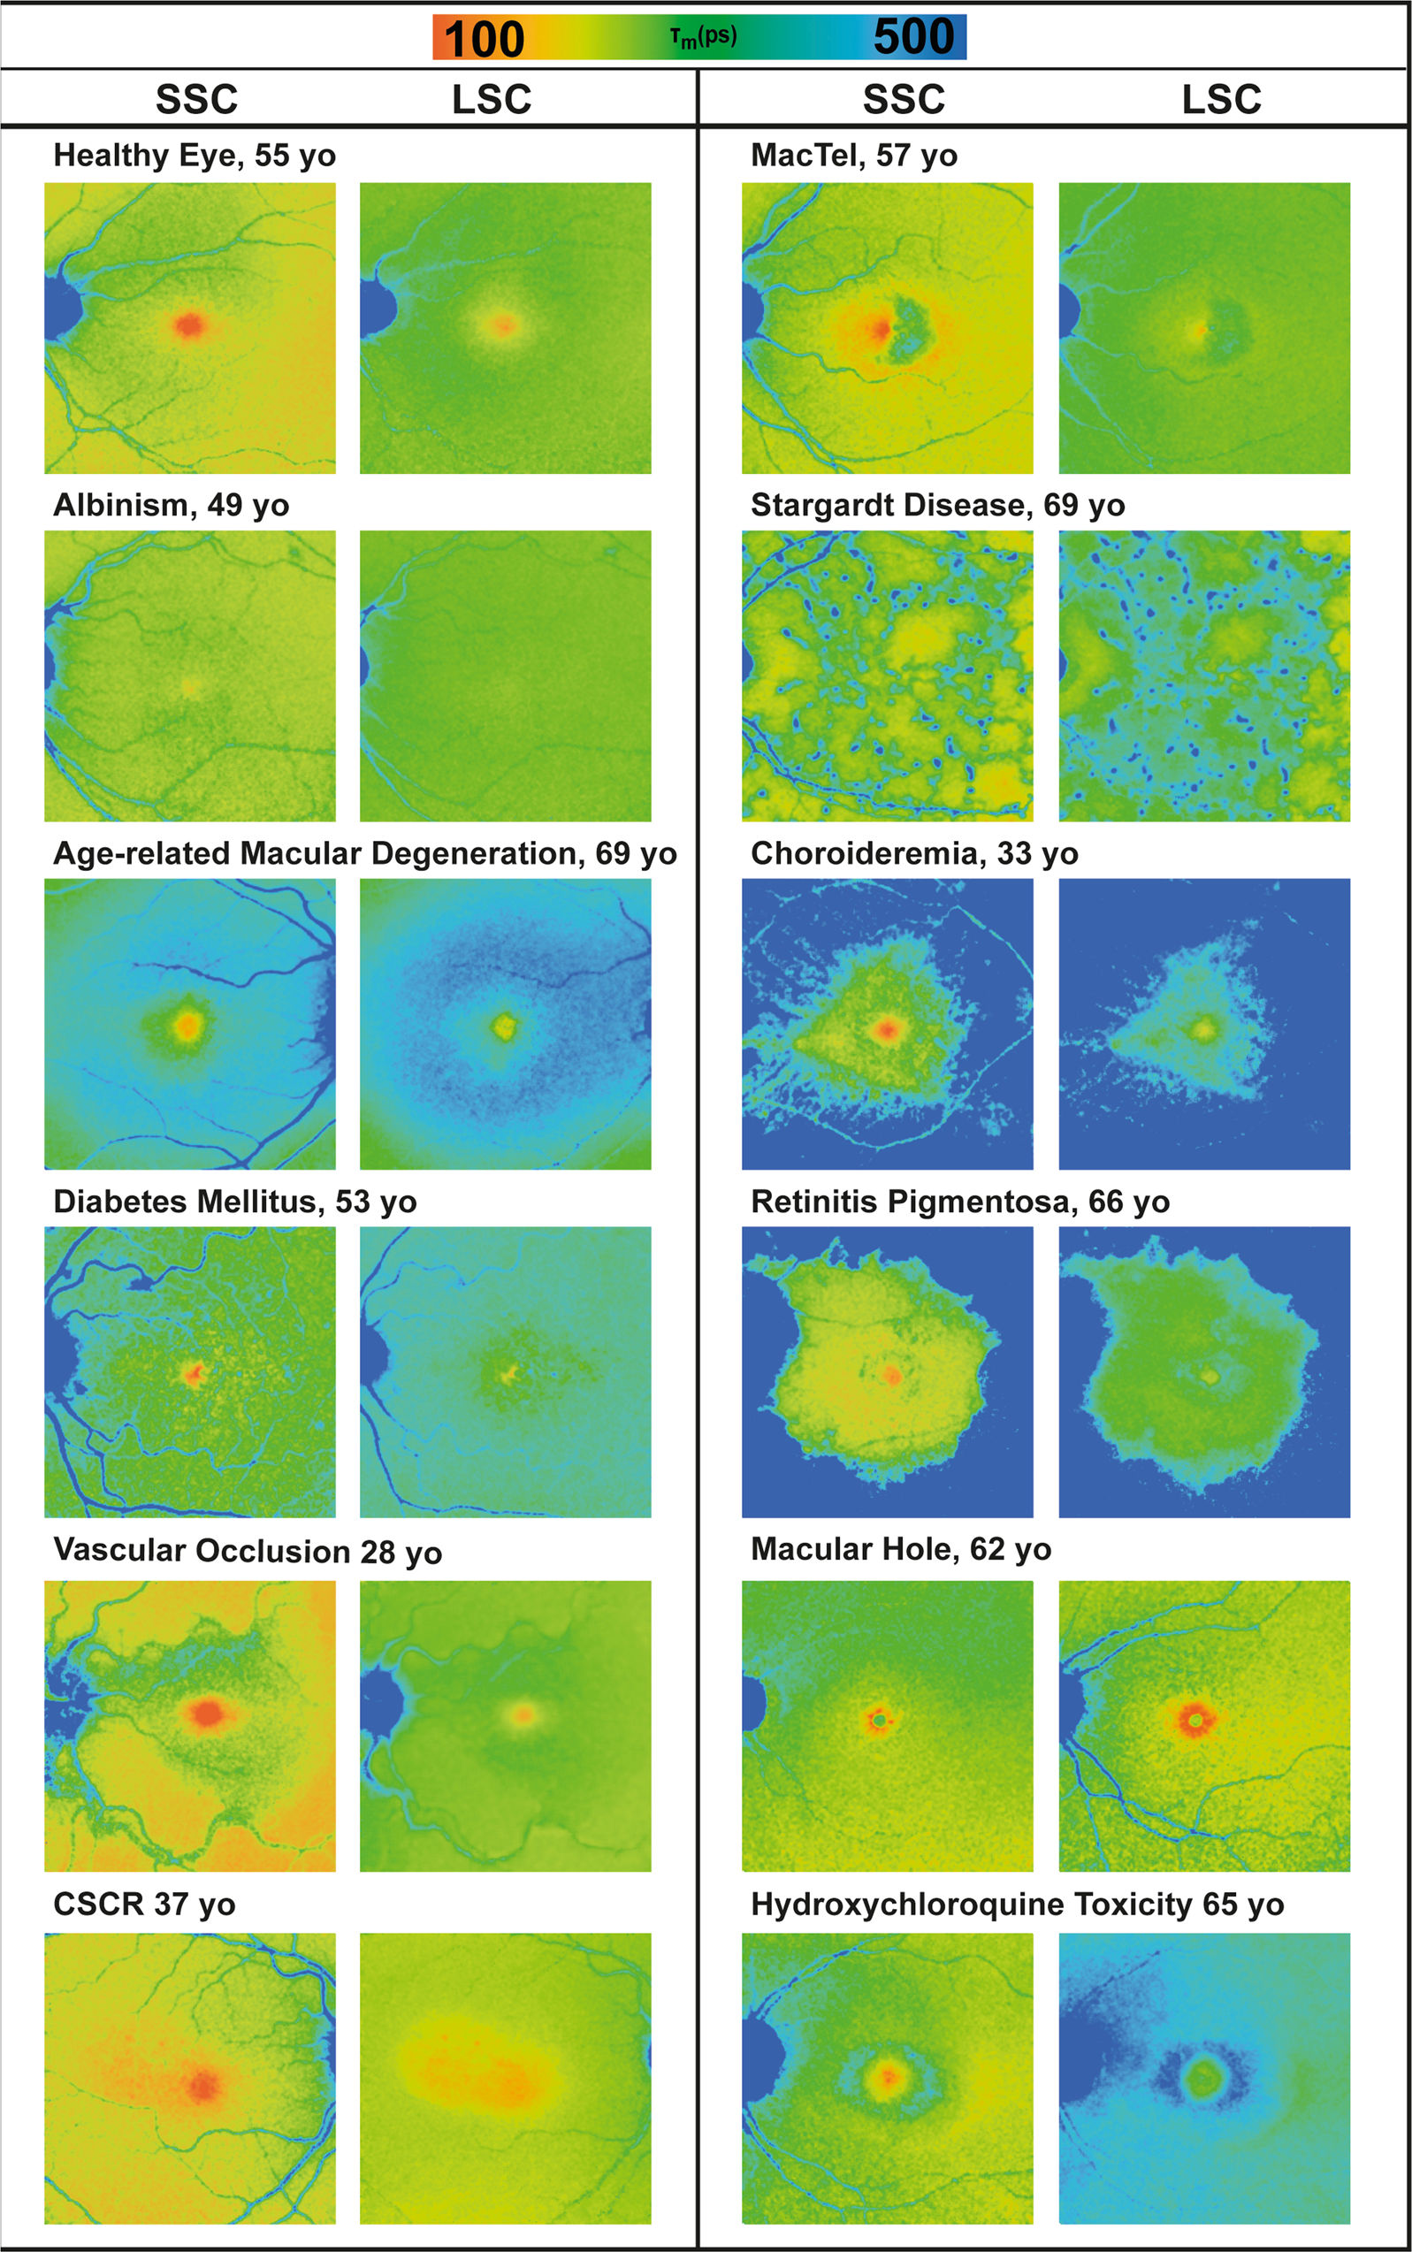
FLIO Summary
Unique dimension of fluorescent imaging
Fast and non-invasive
Early disease detection
Stable patterns
Disease Differentiation
Disease Monitoring
Sauer, Fluorescence, 2020

